Slide 1
Requirements Engineering and Management Module 4 Defining the System
Prof Alok Chauhan
VIT Chennai

Slide 2
Use case

Slide 3
Use Case
We now need to elaborate on features of the proposed system
Use case is the tool which is helpful in this regard
Use cases cover most of the requirements for the system
Developers and users jointly write the use cases
Use cases have a standard format
Use cases lead to test case development later

Slide 4
Use case definition: It represents a function of the system the result of which has some value for an actor of the system
Actor definition: Anyone or anything that interacts with the system
Actor types
End users
Other applications
Any device

Slide 5
Creating the Use-Case Model
Recognize the actors
Users ?
Information consumer ?
Information provider ?
Usage location ?
Support and maintenance ?
Other systems ?
Recognize the Use Cases for each actor
System usage ?
Create, store, change, remove, read data ?
Notify the system ?
Notified by the system ?

Slide 6
Actor and Use-Case Relationships
Initiator (only one actor)
Participator
Use case outlining
Basic flow
Start
End
Repeat
Alternate flow
optional conditions
odd situations
Variants
Mistakes
Impossible
Resource blocking

Slide 7
Refinement
Additional alternate flows and exception conditions
Pre- and post-conditions

Slide 8
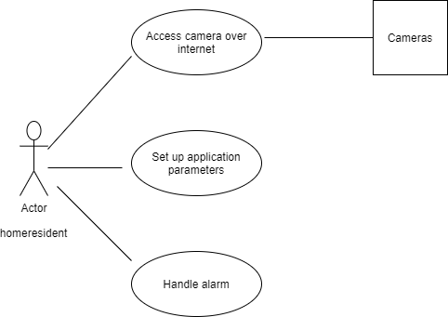
Fig. 1 Example use case

Slide 9
Use Case Standard Format
Four essential elements
Name
Brief description
Actor(s)
Flow of events
basic flow
alternate flows
optional elements
Pre-conditions
Post-conditions
System or subsystem
Other stakeholders
Special requirements

Slide 10
Organizing Requirements Information

Slide 11
Organizing requirements specifications issues
System Complexity
Access levels
Product families
Specification variety
Subsystems
Requirement subset
Commercial goals
Marketing
Business
Legal concerns
Regulatory policies
multiple requirements sets
Vision document
system use-case model
supplementary requirements

Slide 12
Complex systems
Systems which include hardware as well as software systems
Apply systems engineering technique to organize requirements
Represent system in terms of its subsystems (hierarchy of requirements)
Results in generation of new system requirements (derived requirements)

Slide 13
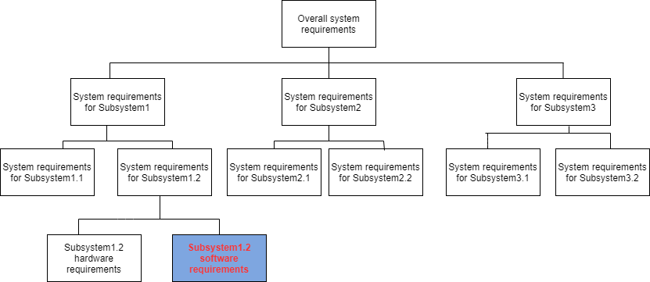
Fig. 2 Complex systems

Slide 14
Product Families
Two levels of organization of requirements
Level1 (family as a system)
vision document
use case model
supplementary specification
Level2 (product as a system)
vision document
use case model
supplementary specification

Slide 15
Vision Document
Scope
User needs (problem domain)
System features (solution domain)
Common project requirements
Intended audience (primary internal stakeholders)
marketing and product management team (proxy for customer/user)
project team
management team

Slide 16
Contents (product version)
Introduction
Purpose
Product overview
references
User details
Demographics
Profiles
Environment
Key needs
alternatives

Slide 17
Product details
Perspective
Position statement
Capabilities
Benefit vs feature
Assumptions/dependencies
Cost/pricing
Feature attributes
Status (proposed/approved/incorporated)
Priority
Effort
Risk
Stability
Target release
Assigned to
reason

Slide 18
Features
Feature1
feature2
Key use cases
Additional product requirements
Standards
Platform requirements
Licensing/security/installation
Performance
Documentation requirements
User guide
Online help
Installation manual/configuration details/read me files
Labeling/packaging
glossary

Slide 19
progression of the Vision document
Vision document v1.0
General
Users and markets
Features of 1.0
Other requirements
Future features

Slide 20
Vision document v2.0 = Vision document v1.0 (+ features of v1.0, + future features)
+ Delta vision v2.0 (+ new features, - removed features, + future features)

Slide 21
Product Management
Key concept is that of a Product Champion
Elicitation management
Conflict management
Features management
Product vision owner
Product advocate
Negotiation with stakeholders
Feature creep management
Bridge between customer and development team
Expectation management of stakeholders
Communication with all stakeholders
Requirement reviewer

Slide 22
Software Product Company
Product Champion = Product Manager
Product manager activities
Vision facilitation
Product road map control
Creating whole product plan
Introduction
Solution summary
Product configuration options
Services and customer support
Commercial terms
Documentation

Slide 23
Supervising the the Use-Case Model and Supplementary Requirements
Product concept testing
Concept generation
Vision
Use case model generation
Alpha testing
Beta testing
User experience completion
Documentation
Presentation
Stating commercial terms
Licensing
Pricing
Customer support

Slide 24
product positioning
For
Who
The (product name)
That
Unlike
Our product

Slide 25
Supporting Activities
Branding and Product Labeling
End User Training Materials
product usage
application method
Product Demo
Sales and Marketing Collateral

Slide 26
Assignment
The Product Champion in an IS/IT Shop

Slide 27
Managing Scope

Slide 28
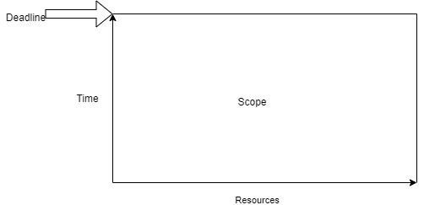
Project scope problem
Fixed resources
Fixed time
Scope actually given is 200% of what we have below
Fig. 3 Project scope

Slide 29
Brooks' law
Functionality miss
Deadline miss
Quality miss

Slide 30
Scope management
Requirements Baseline (ver 1.0)
list of features (25-50)
Setting priorities of features (by customers/users/ product managers—not the development team) why?
critical
Important
useful

Slide 31
Effort assessment for features (rough estimate)
High
Medium
Low
Risk estimates for features (adverse impact on the schedule and/or the budget)
High
Medium
Low

Slide 32
Scope reduction
Scope Prioritization
Based on priority, effort, risk
Reasonable First Estimate
at least the critical items by the deadline

